Slide 1
Economic Mobility
Financial Literacy
Small Business Ownership
Alabama Microenterprise Network (AMEN)
September 24, 2019
Nancy S. Lee
Interise
© 2017, Interise. All rights reserved. Permission required for reproduction and distribution.

Slide 2



AGENDA
Racial wealth gap and economic mobility
Small business and procurement
Systemic change in partnership with capital providers
2

Slide 3
Wealth Gap Statistics
Whites have 10x more wealth than African-Americans and Latinos
Over 25% of African-Americans have no or negative wealth (debt)
The gap is more pronounced in urban areas
  Median wealth of white households in Boston is $247,500, while it is almost zero for African-Americans
By 2046, the wealth of African-American and Latino households could be 1% of white households
3

Slide 4
Disparate Economic Mobility in a Snapshot
Median household income (2017)
  $68,145 White (non-Latino)
  $81,331 Asian
  $40,258 Black
  $50,486 Latino (any race)
$28,000 disparity between white (non-Latino) and black households
How does this happen over generations?
4
Notes:
The racial wealth gap is primarily due to biased historic and current policies and not due to individual choices. These policies have produced:
Lower wages
Higher unemployment
Higher rates of incarceration
Within the African American community.
U.S. policies that contributed to racial wealth gap
Slavery itself kept most African Americans from accruing wealth for the almost 250 years that slavery existed in the U.S.
After slavery ended, the Homestead Act of 1862 gave land for free to overwhelmingly white settlers and thus helped them build assets.
During the Great Depression, FDR’s New Deal built an American middle class but largely excluded African Americans; legislation for the minimum wage.
Social security, unemployment insurance and workers’ compensation excluded agriculture and domestic work, thereby excluding most African Americans.
Post-World War II, the GI Bill of Rights helped to further develop the white middle class, including paying for tuition and low-interest mortgages.

Slide 5
Intergenerational Economic Mobility
Do black and white children have similar economic outcomes based on the income of their parents?
Economic Mobility study (Chetty, et.al., 2018)
  Parental income from 1989 to 2015 when children were ages 11-22.
  Children’s income in 2014-2015 when they were in their mid-30’s.
  Study included outcomes for 20M children.
Source: Raj Chetty, et.al. Race and Economic Opportunity in the United States: An Intergenerational Perspective. March 2018. https://www.nber.org/papers/w24441
5
Notes:
Raj Chetty is an economist at Harvard University and he partners with other researchers at Stanford University and Rhode Island. His work in economic mobility is very in depth and comprehensive. He and his team make the findings accessible to technical and non-technical audiences. More economic mobility research and findings may be read at https://opportunityinsights.org/paper/

Slide 6
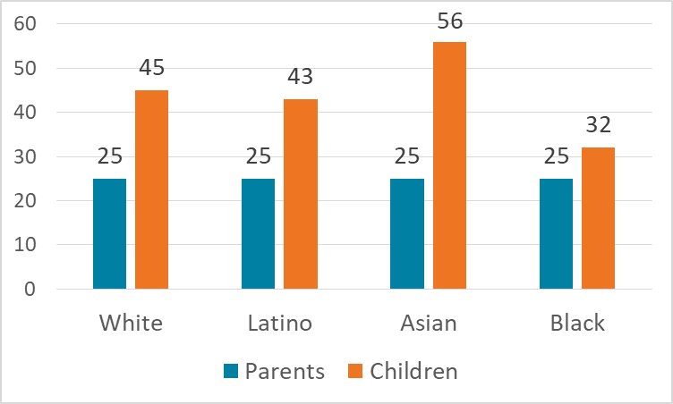
Children’s Earnings Outcomes for Lower Income Parents (25th percentile)
+20
+18
+31
+7
6
Notes:
Percentile examples: A child in the 90th percentile of height for her age is taller than 90% of children that age. A student who tested in the 40th percentile on a standardized test means 40% of student scored lower and 60% of students scored higher.
In the chart, the gains of Latino children relative to white children are about the same. This means the economic mobility gains of white and Latino children whose parents were in the 25th percentile of income were similar. In other words, at the lower levels of income, Latinos are catching up to whites. Asian children have exceed white children. However, black children, while they have passed their parents in income, they lag behind the other three demographic groups. This feeds the cycle of losing ground with each generation.

Slide 7
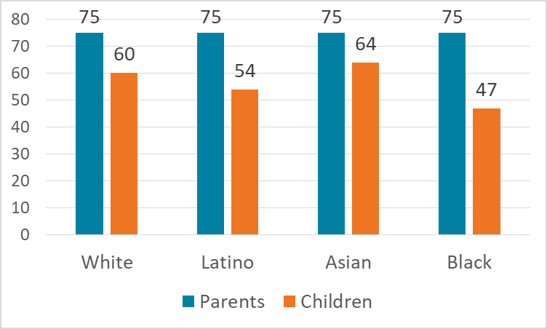
Children’s Earnings Outcomes for Higher Income Parents (75th percentile)
-15
-11
-21
-28
7
Notes:
At higher income levels, the outcomes for black children are much lower (by 13 percentiles) than white children. Economic mobility is lower among children from families with higher incomes too.
Note that for Latinos in this category, the gains are not close to whites.
Unlike Latinos, African Americans are not gaining economic mobility anywhere along the income spectrum.

Slide 8
Additional Intergenerational Outcomes
African Americans have lower rates of upward mobility and higher rates of downward mobility.
Disparity is driven by wages and employment differences between black and white men.
Very little disparity exists between black and white women.
Disparity is not explained by parents’ education, marital status, or wealth.
8
Notes:
The Chetty, et.al. report showed a stark finding that the economic mobility disparity is driven by negative outcomes for black men.
Disparity is not explained by the negative stereotypes attributed to minorities, especially African Americans, of “stay in school,” “get married/stay married,” or “work harder.” See the next slide for additional data.

Slide 9
Bootstraps are Not Enough
Median Household Wealth Comparisons
Source: McFeely and Lee, 2017. Small Business and the Racial Wealth Gap.
https://www.interise.org/blog-news/interise-insights/7860-wealth1
9
Notes:
The “pull yourself up by your bootstraps” vision of the American Dream attributes the wealth gap to individual choice and claims that the gap can be solved with:
Education
Marriage and family structure
Full-time employment
Spending habits
While these factors are important, they don’t fully close the wealth gap.
Wealth disparities are clear for black and Latino households when compared to white households, despite making good “life choices.”

Slide 10
Additional Intergenerational Outcomes
Black and white boys have more similar outcomes when they grow up
  In low-poverty neighborhoods,
  With low levels of racial bias among whites, and
  With high rates of a present father among blacks.
  However, fewer than 5% of African American children grow up in such environments.
10

Slide 11
Need for Systemic Change that Affects Intergenerational Outcomes
Need to change systematically.
Improve all systems that affect neighborhoods (housing, public health, public transportation, K-12, economy, etc.)
Reduce racial and class biases.
Create and increase opportunities for better income, financial literacy, and small business outcomes.
11

Slide 12
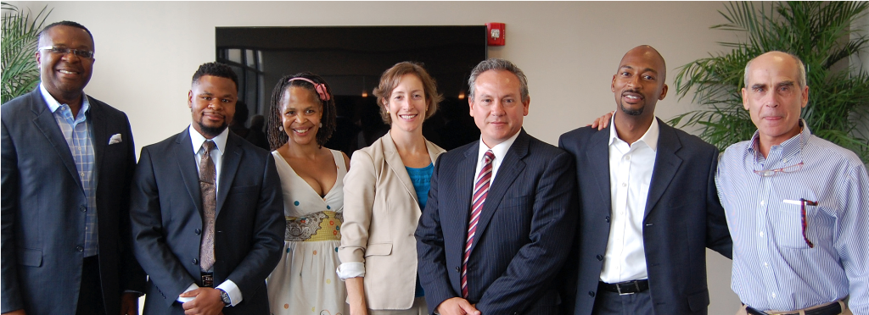
© 2016, Interise. All rights reserved.
Systemic change through small business ownership, capacity building, procurement,
and access to capital.
Notes:
Resources for small business development already exist. They are often centered on:
Access to capital
Supplier diversity
Technical assistance
Capacity building
Definitions:
Technical assistance:
Focuses on a particular situation
Is short-term
Capacity building
Requires sustained determination to continual improvement over time.
It focuses on:
Business systems and operations
The business owner's expertise in management & strategy
Training: builds skills
While all systems are interconnected and need to be shifted towards equity, our focus is on the small business ecosystem, especially for minorities in low- and moderate-income communities. This includes systems related to the small business ecosystem such as changing the microcosm of individual businesses from working “in” to working “on” their businesses. It moves the CEO from day to day operations to strategy—a system change for growth.
Procurement systems is an organic way for small business growth.
Access to capital is a chronic challenge for small business owners, with extra hurdles for minority business owners, especially coupled with low credit scores and insufficient collateral. What can be done to support these circumstances?

Slide 13
Outcomes for Business Owners
African-American business owners have 12x more wealth than non-business owners.
Minority business owners are more likely to hire minorities and to hire locally.
Interise impact data shows minority alumni grow revenue and jobs at a higher rate.
Not only does entrepreneurship benefit the owner, it creates B-to-B transactions, and bolsters families through job creation.
13

Slide 14
Wealth a Common form of Capital
for Small Business Owners
Sources of capital for small business owners
  Personal savings
  Home equity
  Family and friends
  Personal credit cards, loans
  Lines of credit
But minority business owners often have lower personal credit scores and insufficient capital
14

Slide 15
Capacity Building and Training
Capacity building programs systematically change the business (e.g. Emerging Leaders, StreetWise ‘MBA’™)
  Provide business fundamentals
  Impart understanding of strategy to move from working “in” to working “on” the business
  Change CEO behavior over time
Training build skills and technical assistance addresses a specific issue
15

Slide 16
Procurement Accelerates Business Growth
Contracting with anchor institutions, corporations, and government can lead to business growth
Grows a business organically
Diversifies revenue streams
Promotes supplier diversity
Invests in the community
16

Slide 17
Leadership in Equitable Anchor Procurement (LEAP)
Systems approach to increasing mutually beneficial contracting opportunities
Establishes a common goal and builds trust
  Business owners
  Anchor procurement leadership and staff
  Capital providers
  Capacity builders
Surface mental models (implicit biases) that become leverage points to realign the system
17

Slide 18
Common Procurement Mental Models
Procurement
MWBEs, DBEs are unknown quantities/too small.
I’m judged on short term results of best product, best price.
It’s always been done this way. Why change.
Small Business
Why do anchors need my financials/so much paperwork?
Because the company is certified, it should be awarded contracts.
Why should I try? The same companies always get the contracts.
18
Notes:
Do these mental models (biases) sound familiar? These are examples of biases that are uncovered at LEAP workshops. We use these as leverage points to shift the procurement system towards more win-win contracting opportunities for anchors institutions, corporations, and other large buyers and MWBEs and DBEs. For example, when procurement staff get to know MWBEs, they realize they have strong capabilities and track records for delivery. At the same time, MWBEs need to be contract ready and to demonstrate their capabilities. Each stakeholder understands and is accountable for their impact to the system.

Slide 19
Capital Providers and Procurement
Provide working capital when a contract is won, growth capital, and startup capital
Refer to alternative lenders and appropriate size banks
Work with local economic development organizations on referrals to lenders and financial literacy services
Work with unbanked and unscored individuals establish a credit profile
19
Notes:
In keeping with the financial literacy theme of this Forum, here are some typical and innovative tactics and ideas for capital providers to consider to help shift the financial system to be more beneficial to small business.

Slide 20
Capital Providers Changing the System
Help negotiate payment terms of a new procurement contract
Help educate anchors and corporations on small business cash flow
Use contracts as collateral
Establish revolving loan funds for procurement
Establish collateral assistance funds for construction surety bonds
20

Slide 21
Capital Providers Changing the System
Help business owners establish a business profile as early as possible
Reduce risk to personal credit
Report to the business credit bureaus
Help make the business credit scores more transparent and better understood
Increase awareness of industry specific credit reporting agencies
Encourage suppliers to report payment history
21

Slide 22

Questions and Discussion
Nancy S. Lee
Director Research
and Evaluation
nlee@interise.org
617-350-6316
Bernard Johnson
Director Programs
bjohnson@interise.org
617-350-6334
© 2016, Interise. All rights reserved.
22

